Slide 1
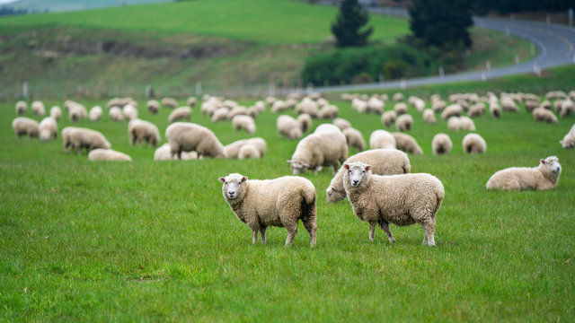
A Taste for Diversity: Microbial Community Shifts in Sheep’s Milk Cheeses
Chloe McGovern
Notes:
Hi everyone, my project i have been working on is looking at microbial communities across cheese made from sheeps milk

Slide 2
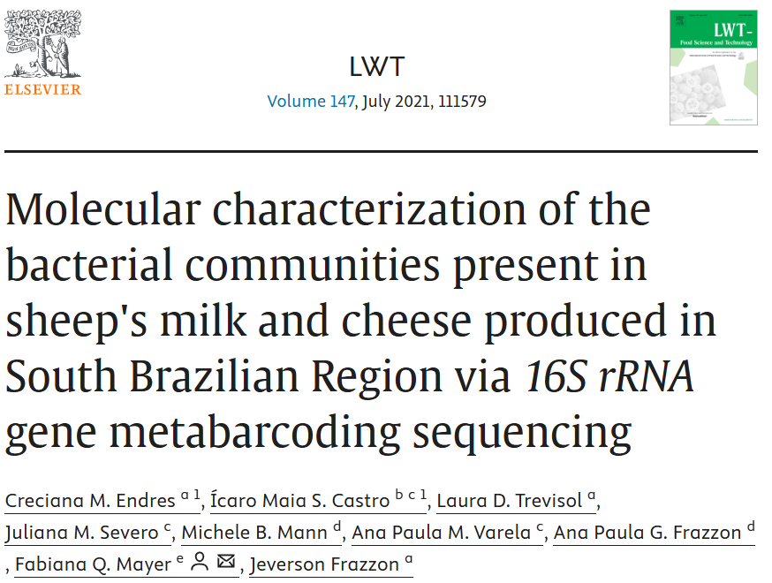
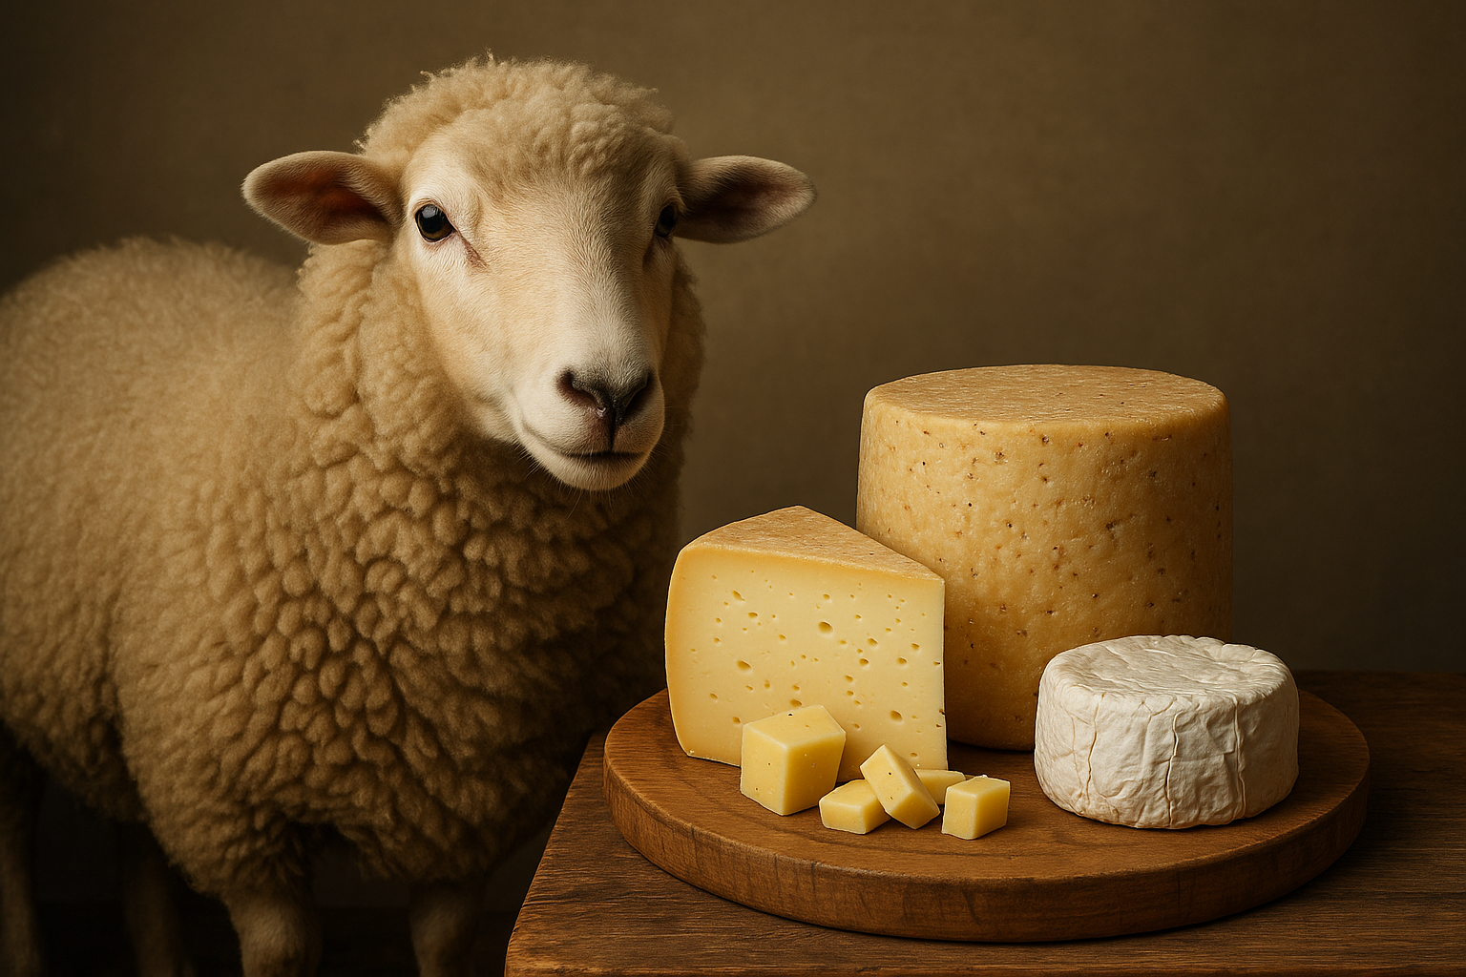
Revisiting a study of sheep’s milk cheese microbiomes in Brazil.
Image generated with AI
Notes:
This project came from this paper where the researchers looked at raw sheeps milk and cheese but they were broken up into two different projects so i just wanted to look at the cheese because it’s more enjoyable
While i could go extensively on why i chose this paper, briefly it is because i am really interested in microbial communities within food–especially within fermented food systems in terms of precision fermentation, metabolites, but also
this project reanalyzes data from a 2021 study that profiled the bacterial diversity of artisanal sheep’s milk cheeses produced in Brazil. While the original paper focused on characterizing community composition across cheese types, I wanted to explore whether cheese style truly shapes microbial structure — especially when we zoom in to specific ASVs

Slide 3
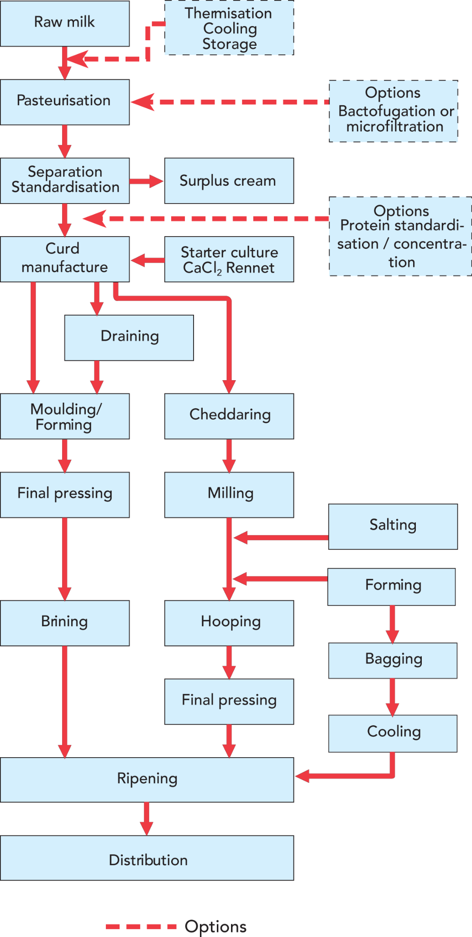
Different types of cheeses have different processing parameters, regulations, and starter cultures.
Colonial: aged, pressed cheese, similar to cheddar
Feta-type: brined, crumbly, short/minimal aging
Fresh: No aging, high moisture, minimal processing
Pecorino-type: hard, dry-aged
From Tetra Pak Dairy Processing Handbook

Slide 4
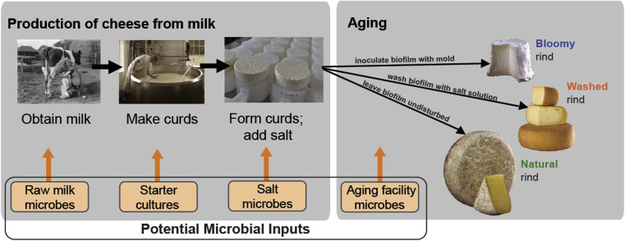
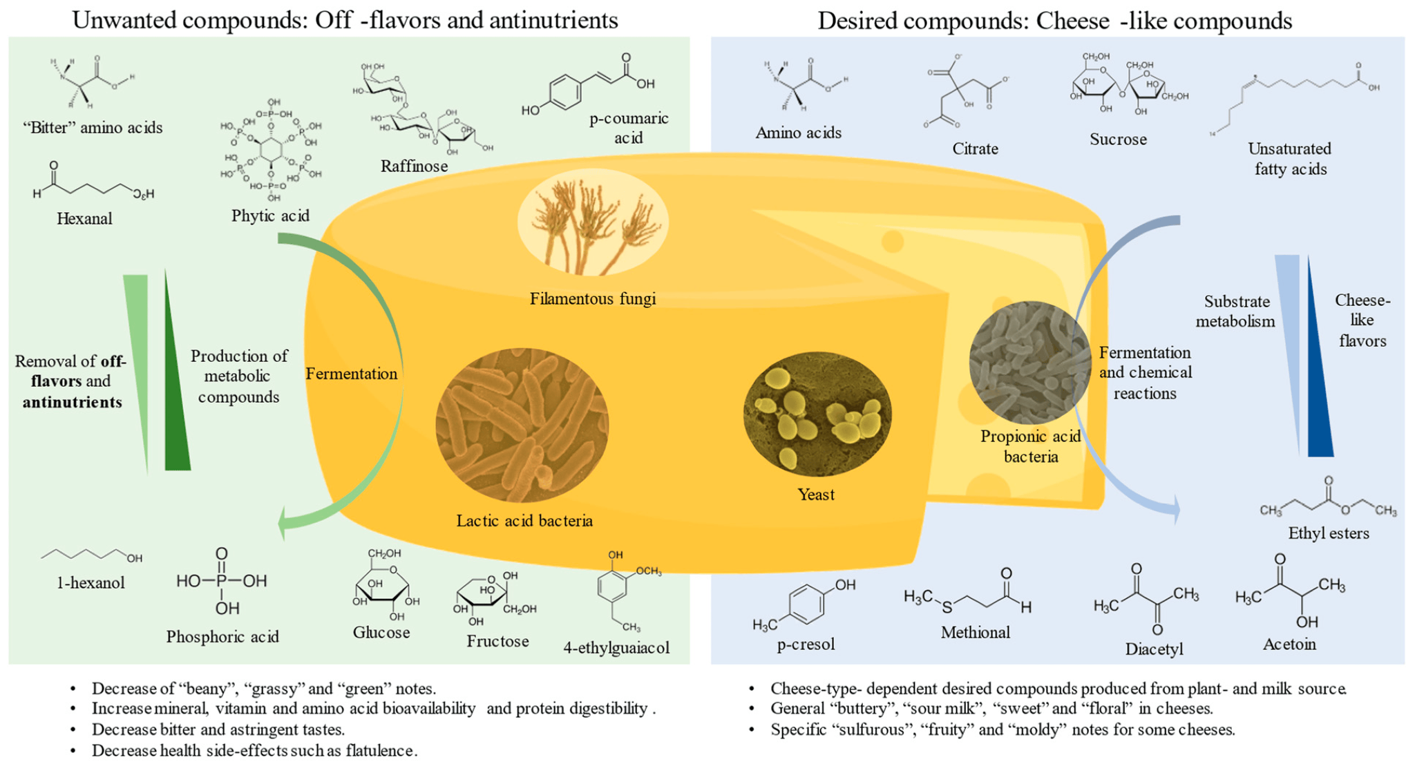
Microbial communities play an important role in cheese production.
Top figure from Benjamin Wolf et al., 2014
Bottom figure from Blandine Genet et al., 2023
Notes:
I am sure we have all eaten a fermented food and if you are lactose intolerant you maybe haven’t tried different cheese but at least visually we can all connect the dots between
However, cheese vats are open systems so bacteriophages are a concern. Strain level specificity of different
organoleptic characteristics of these cheeses are influenced by several factors, including the raw materials used, geographic region of the property, seasonality, sheep feed, sheep breed, manufacturing process, and maturation period

Slide 5
Does cheese type influence microbial community composition?
And are those differences only visible at finer taxonomic scales?
Null
Cheese type does not influence microbial community composition.
Alternative
Cheese type does influence microbial community composition.

Slide 6
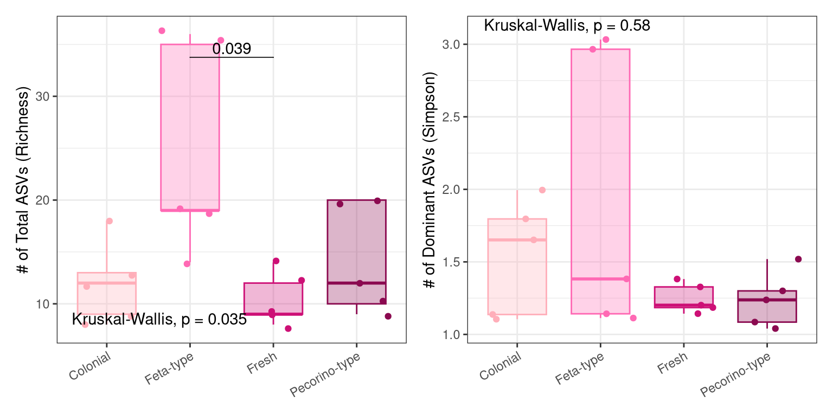
Some cheese types harbor a broader range of microbes, but overall cheese types are dominated by a few taxa.
Notes:
Break up
Cheese type shapes the microbial community composition, as shown by clear clustering in both Sorensen (presence/absence) and Bray-Curtis (abundance-based) PCoA plots.
Feta-type cheeses appear most distinct, particularly in Bray-Curtis, suggesting they harbor unique and more abundant taxa.
Alpha diversity shows significantly higher richness in Feta-type cheeses, but no difference in dominance, pointing to a more even distribution of microbes.
These differences in community structure support the hypothesis that cheese type influences microbiota, motivating a closer look at which taxa are driving these trends at the phylum, genus, and ASV levels.
The Feta-type cheeses show the most spread, which could indicate inconsistent fermentation or environmental variation during production.
This suggests that while some cheeses harbor a broader range of microbes (richness), the overall structure remains consistently dominated by a few taxa (simpson)
That variability could stem from differences in starter culture control, salt concentration, or aging conditions.

Slide 7
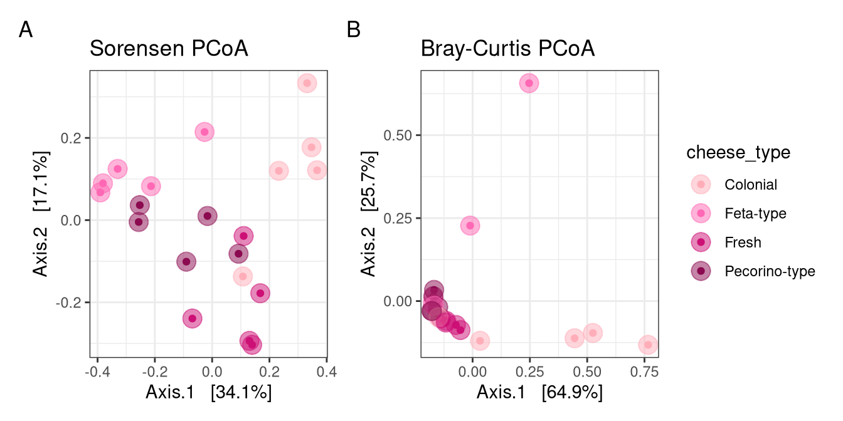
Community shifts are cheese dependent, but not uniform
Notes:
So many things to say about this
Sorensen looks as we expect it to from previous slide, that there is a different in microbial presence/absence (range of microbes) so we do see some variance or maybe slight separation in groups. But I want to say a bit more about the bray curtis side of the plot. It also

Slide 8
Community shifts are cheese dependent, but not uniform. Batch dependent nature of cheese manufacturing may be a more accurate driver of change.
Notes:
So many things to say about this
Sorensen looks as we expect it to from previous slide, that there is a different in microbial presence/absence (range of microbes) so we do see some variance or maybe slight separation in groups. But I want to say a bit more about the bray curtis side of the plot. It also

Slide 9
Does cheese type influence microbial community composition? Yes!
And are those differences only visible at finer taxonomic scales?

Slide 10
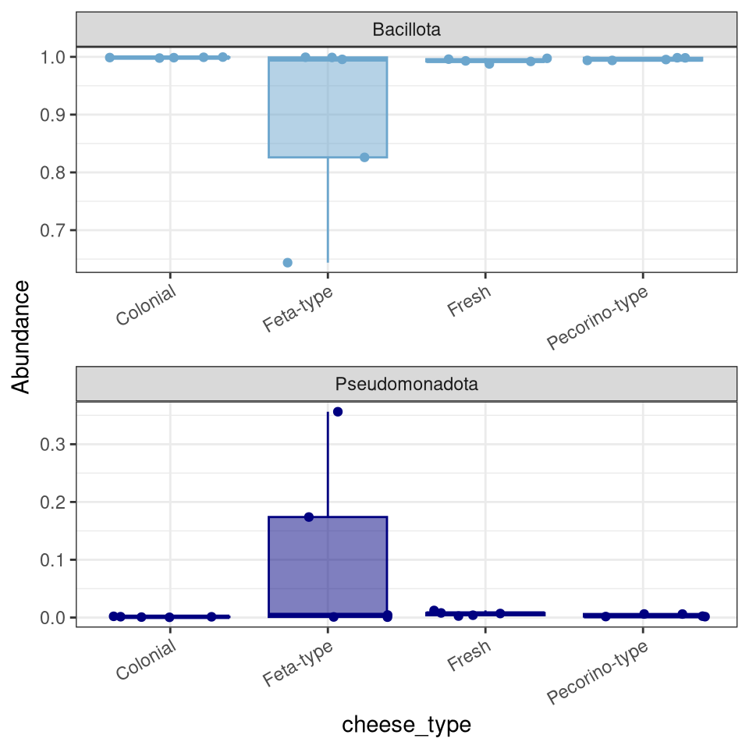
At the phylum level, cheese type shows limited influence on microbial composition.

Slide 11
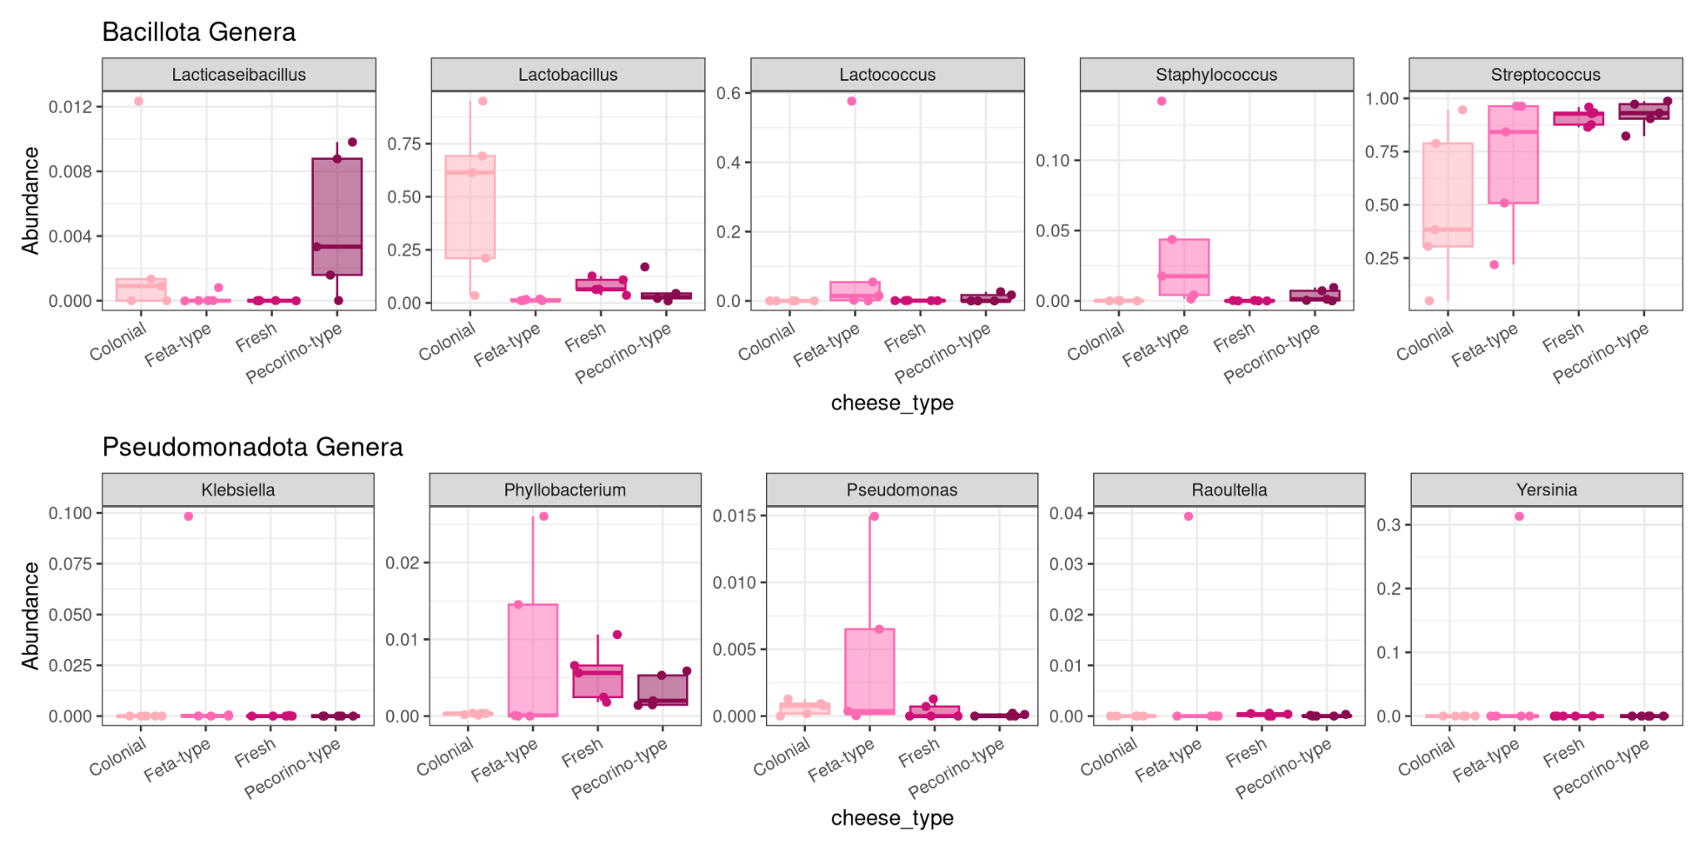
Dominant genera like Streptococcus appear across all types potentially as a starter culture. Others like Pseudomonas are sporadic and may reflect environmental contamination.
Notes:
This could be due to…
Starter cultures
Contamination
Human - open vat systems
Animal - raw milk or sanitation

Slide 12
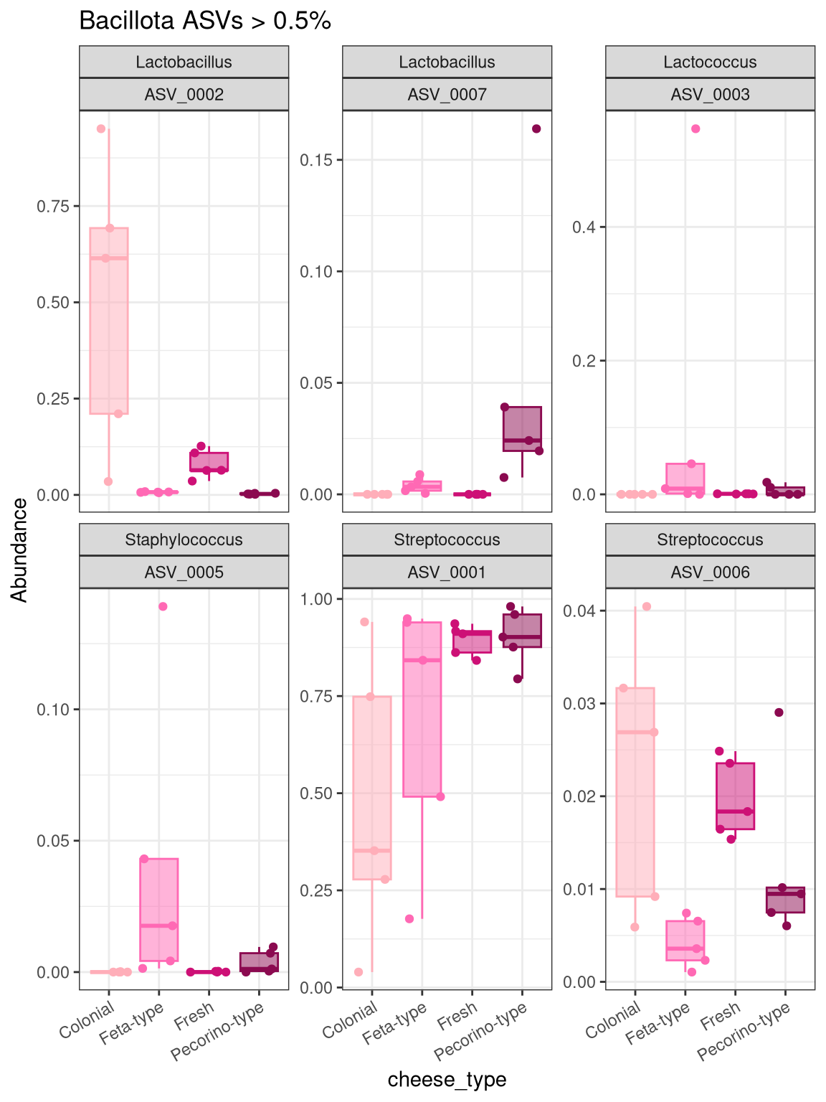
Distinct ASVs dominate different cheese types.
Streptococcus ASV_0001 is most abundant in Pecorino-type, while Lactobacillus ASV_0002 is highest in Colonial
Varience within cheese-types

Slide 13
Does cheese type influence microbial community composition? Potentially!
And are those differences only visible at finer taxonomic scales? Yes!
Null
Cheese type does not influence microbial community composition.
Alternative
Cheese type does influence microbial community composition.

Slide 14
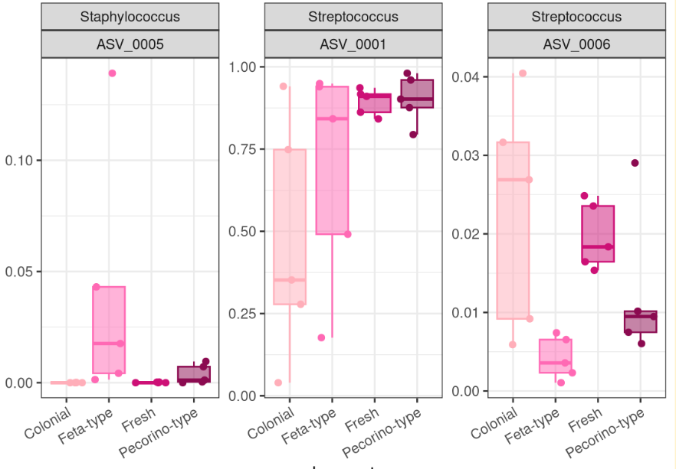
Food microbial communities are a great example as to why absolute data matters!
Who wants to eat cheese that has this in it?!
Indicative of poor pasteurization, mastitis infections, farm/facility sanitation conditions, even phages. Without absolute data it is difficult to draw biological conclusions.
Note: One of these Streptococcus ASVs is most likely a probiotic, while another is most likely a pathogen but without context we don’t know.

Slide 15

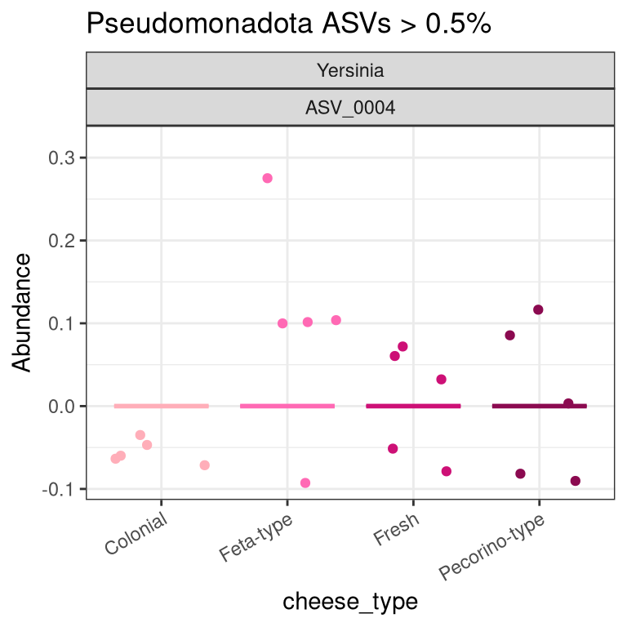
Yersinia in feta-type cheese as a model for the importance of microbial monitoring in food processing.
Image generated with AI

Slide 16
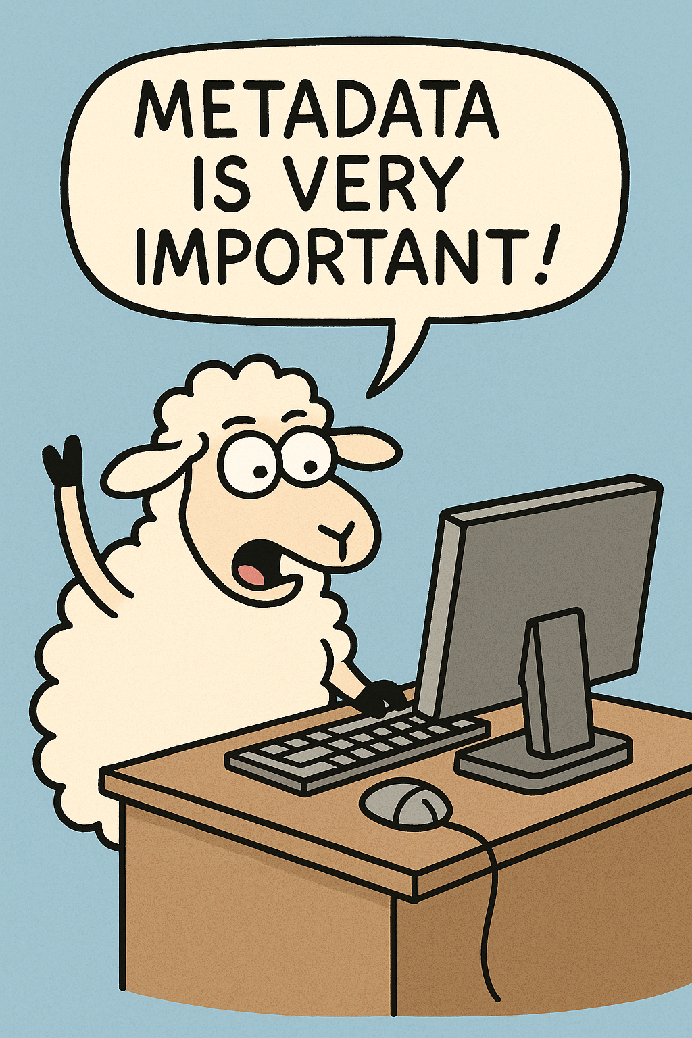
Where this dataset falls short and why that matters
Metadata would dramatically change the interpretation of these results.
Pasteurization and processing (salt!)
Starter cultures
Phages
Level of contaminants limit the biological interpretations happening within the system
Image generated with AI

Slide 17
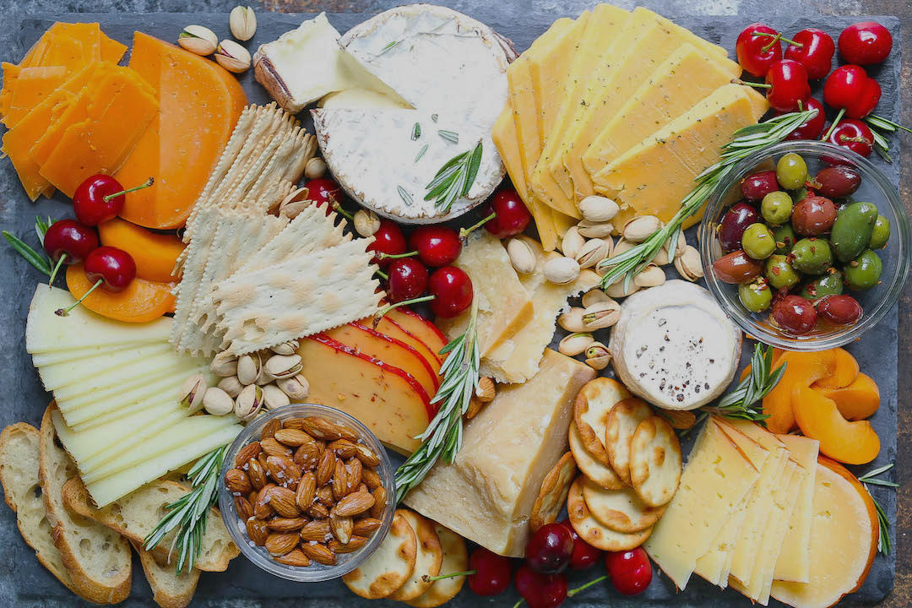
Questions?
Thanks for listening!

